Slide 1

Assignment Ch 3
Building a Data Ingestion Pipeline with Apache Sqoop, Flume, and Kafka on a Local Machine

Slide 2
Objective:
The primary goal is to design and implement a data pipeline that integrates both batch processing (using Apache Sqoop) and real-time streaming (using Apache Flume and Apache Kafka).
Scenario:
The scenario involves setting up an environment on a local machine where historical data from a relational database (e.g., MySQL) is migrated to Hadoop's HDFS. Simultaneously, real-time streaming data from local files is handled, ensuring seamless data flow using Apache Kafka.
Components:
Apache Sqoop: Used for batch data migration from relational databases to HDFS.
Apache Flume: Handles real-time data ingestion from local files.
Apache Kafka: Manages and ensures real-time data flow.

Slide 3
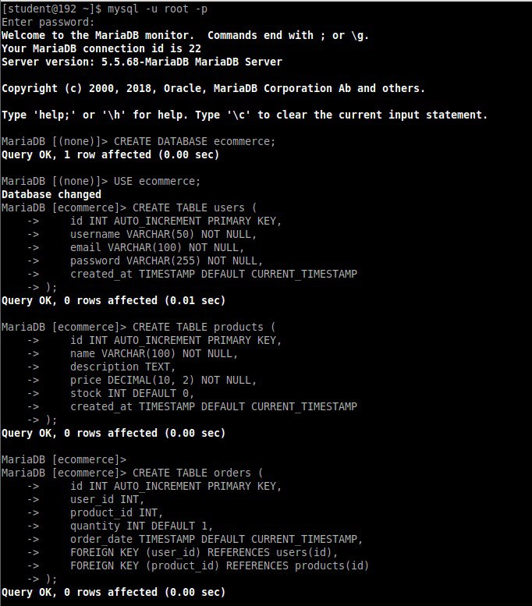
Connecting to MariaDB: Logged into the MariaDB server using the mysql command.
Creating the Database: Command: CREATE DATABASE ecommerce;
Purpose: Establish a new database named ecommerce to store all related data.
Creating Tables:
Users Table: Contains fields like id, username, email, password, and created_at.
Products Table: Includes fields such as id, name, description, price, stock, and created_at.
Orders Table: Has fields like id, user_id, product_id, quantity, order_date, and foreign keys linking to users and products

Slide 4

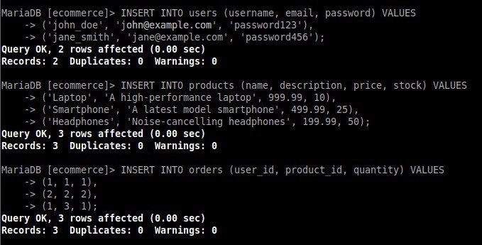
Users: Added two users, John Doe and Jane Smith.
Products: Added three products: a laptop, a smartphone, and headphones.
Orders: Added three orders linking users to products with specified quantities.

Slide 5
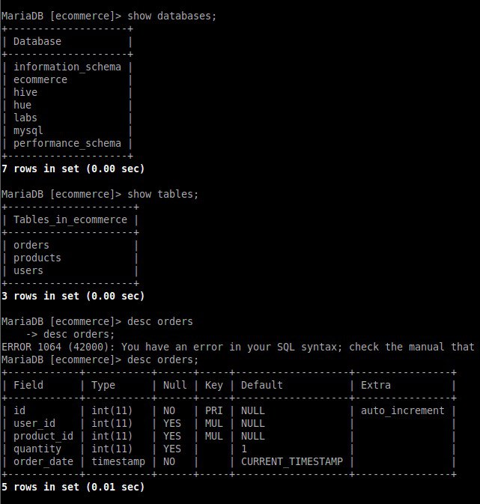
Showing Databases:
Command: SHOW DATABASES;
Outcome: Listed available databases, including ecommerce, mysql, and others.
Showing Tables:
Command: SHOW TABLES;
Outcome: Displayed tables within the ecommerce database: orders, products, and users.
Describing Table Structure:
Command: DESC orders;
Outcome: Displayed the structure of the orders table, including fields like id, user_id, product_id, quantity, and order_date

Slide 6
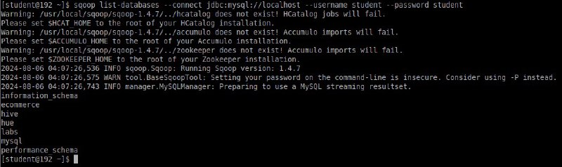
Importing Data with Sqoop
Listing Databases:
Command: sqoop list-databases --connect jdbc:mysql://localhost --username student --password student
Outcome: Listed databases including information_schema, ecommerce, hue, labs, mysql, and performance_schema.

Slide 7
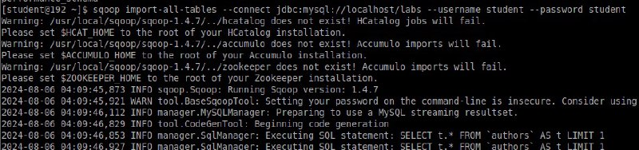
Importing All Tables with Sqoop
Importing Tables:
Command: sqoop import-all-tables --connect jdbc:mysql://localhost/labs --username student --password student
Outcome: Attempted to import all tables from the labs database.

Slide 8
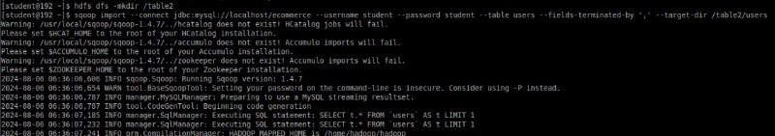
Importing Users Table with Sqoop
Creating Directory:
Command: hdfs dfs -mkdir /table2
Outcome: Created a directory named /table2 in HDFS.
Importing Table:
Command: sqoop import --connect jdbc:mysql://localhost/ecommerce --username student --password student --table users --fields-terminated-by ',' --target-dir /table2/users
Outcome: Attempted to import the users table from the ecommerce database into the /table2/users directory in HDFS.

Slide 9
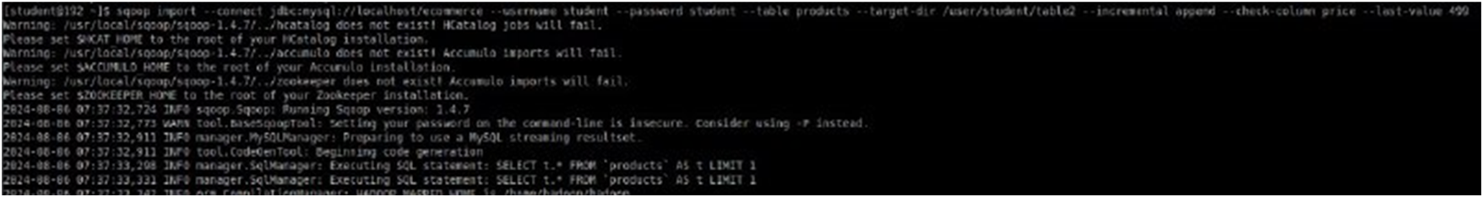
Importing Products Table with Sqoop
Importing Table:
Command: sqoop import --connect jdbc:mysql://localhost/ecommerce --username student --password student --table products --target-dir /user/student/table2 --incremental append --check-column price --last-value 499
Outcome: Attempted to import the products table from the ecommerce database into the /user/student/table2 directory in HDFS with incremental append based on the price column.

Slide 10
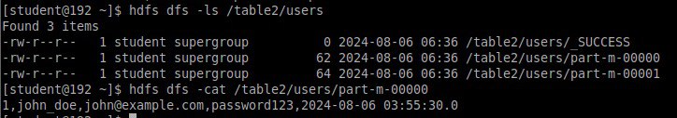
Listing Files in HDFS
Command: hdfs dfs -ls /table2/users
Outcome: Listed files in the /table2/users directory.
Files Found:
SUCCESS: Indicates the successful completion of a job.
part-m-00000, part-m-00001: Data files generated by the job.
Viewing File Content:
Command: hdfs dfs -cat /table2/users/part-m-00000
Outcome: Displayed content of the file, showing user data such as id, name, email, password, and timestamp.

Slide 11
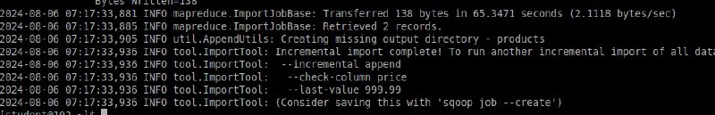
Incremental Import of Products Table with Sqoop
Importing Table:
Command: sqoop import --connect jdbc:mysql://localhost/ecommerce --username student --password student --table products --target-dir /user/student/table2 --incremental append --check-column price --last-value 499
Outcome: Successfully imported the products table with incremental append based on the price column.
Transferred Data:
Details: Transferred 138 bytes in 65.3471 seconds, retrieving 2 records.

Slide 12
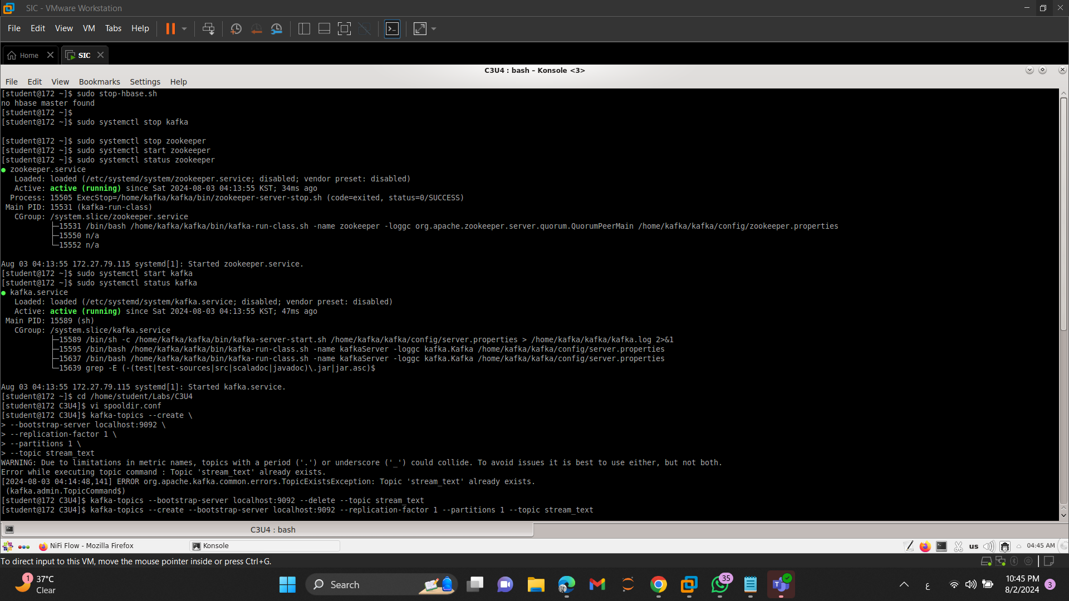
Managing Zookeeper and Kafka Services
1. Stopping Zookeeper:
Command: sudo systemctl stop zookeeper
Outcome: Stopped the Zookeeper service.
2. Starting Zookeeper:
Command: sudo systemctl start zookeeper
Outcome: Started the Zookeeper service.
3. Checking Zookeeper Status:
Command: sudo systemctl status zookeeper
Outcome: Zookeeper service is active and running.
4. Starting Kafka:
Command: sudo systemctl start kafka
Outcome: Started the Kafka service.
5. Checking Kafka Status:
Command: sudo systemctl status kafka
Outcome: Kafka service is active and running.

Slide 13
Navigating and Editing Configuration Files
Navigating to Documents Directory:
Command: cd /home/student/Documents
Outcome: Changed directory to /home/student/Documents.
Editing Configuration File:
Command: vi spooldir.conf
Outcome: Opened the spooldir.conf file for editing using the vi editor.

Slide 14
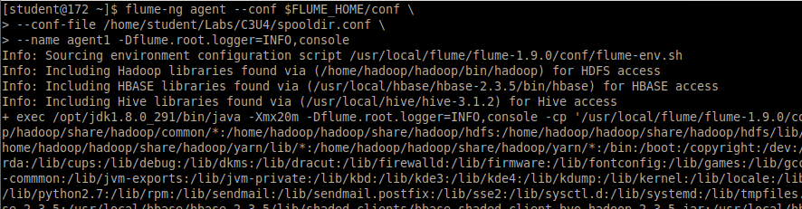
Starting a Flume Agent
Command:
flume-ng agent --conf $FLUME_HOME/conf --conf-file /home/student/Labs/C3U4/spooldir.conf --name agent1 -Dflume.root.logger=INFO,console
Outcome: Starts a Flume agent named agent1 with the specified configuration file and logging settings.
This command is used to start a Flume agent named agent1 with the specified configuration file and logging settings.

Slide 15
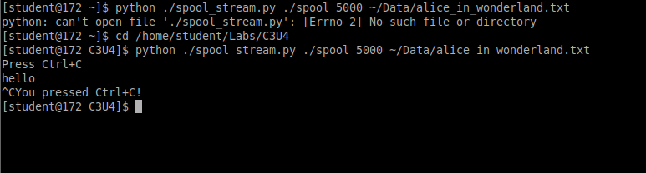
Running a Python Script and Navigating Directories
Running Python Script:
Command: python ./spool_stream.py ./spool 5000 ~/Data/alice_in_wonderland.txt
Outcome: Attempted to run the script but encountered an error: “No such file or directory”.
Changing Directory:
Command: cd /home/student/Labs/C3U4
Outcome: Changed directory to
/home/student/Labs/C3U4

Slide 16
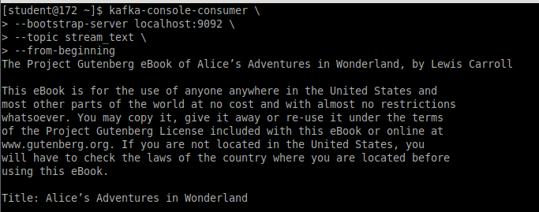
Consuming Kafka Streams with Kafka Console Consumer
kafka-console-consumer: This is the Kafka command-line tool used to read messages from a Kafka topic.
--bootstrap-server localhost:9092: Specifies the Kafka broker to connect to. it’s running on localhost at port 9092.
--topic stream_text: Indicates the topic from which messages will be consumed. Here, the topic is stream_text.
--from-beginning: Tells the consumer to read messages from the beginning of the topic, rather than starting from the latest message.

